Slide 1


PHP Basics

Slide 2

Pease Scan it!

Slide 3
What is PHP?
PHP (Hypertext Preprocessor, originally Personal Home Page) is a server-side scripting language designed for web development. It is embedded in HTML and executed on the server, generating dynamic content that is then sent to the user's browser.
Server-Side Execution
Runs on the web server (e.g., Apache, Nginx), not in the browser.
Processes data and returns HTML, CSS, or JSON to the client.
Open-Source & Free
No licensing costs; widely supported by hosting providers.
Cross-Platform
Works on Windows, Linux, macOS, and integrates with databases like MySQL, PostgreSQL, and MongoDB.
Easy to Learn
Syntax similar to C, Java, and Perl.
Beginner-friendly with extensive documentation.
Database Integration
Commonly used with MySQL for dynamic websites (e.g., blogs, e-commerce).
Large Ecosystem
Powers major platforms like WordPress, Drupal, and Laravel.

Slide 4
Why Use PHP?
Easy to learn and use
Simple syntax – Similar to C, Java, and Perl
Low Entry Barrier – Beginners can start quickly with basic HTML integration
Great Documentation – Official PHP manual and countless tutorials.
Open Source & Free
No Licensing Costs – Unlike proprietary languages (e.g., .NET).
Extensible – Developers can modify the source code
Wide Hosting Support – Almost all web hosts support PHP (e.g., Bluehost, SiteGround).
High Performance
Faster Execution – PHP 8 introduced JIT (Just-In-Time) Compilation, making it 3x faster than PHP 5
Optimized for Web – Handles thousands of requests per second (used by Facebook, Wikipedia).
Built for Web Development
Form handling ($_GET, $_POST).
Session & cookie management.
File uploads & processing.
Headers & HTTP response control.

Slide 5
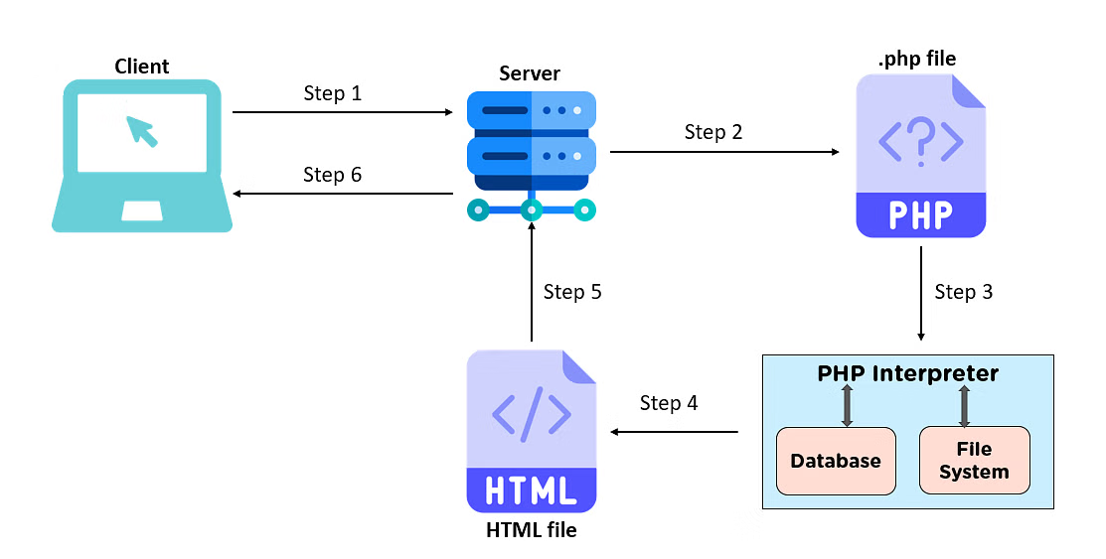
How PHP Works?
The client requests the webpage the browser.
The server (where PHP software is installed) then checks for the .php file associated with the request.
If found, it sends the file to the PHP interpreter (since PHP is an interpreted language), which checks for requested data in the database.
The interpreter then sends back the requested data output as an HTML webpage (since a browser does not understand .php files).
The web server receives the HTML file from the interpreter.
, And it sends the webpage back to the browser.

Slide 6

Real-World PHP Applications
Where PHP is Used in Production:
Facebook (Originally built on PHP, later optimized with Hack).
Wikipedia (MediaWiki runs on PHP).
WordPress (43% of all websites).
Magento/WooCommerce (E-commerce platforms).
Slack (Early versions used PHP).

Slide 7
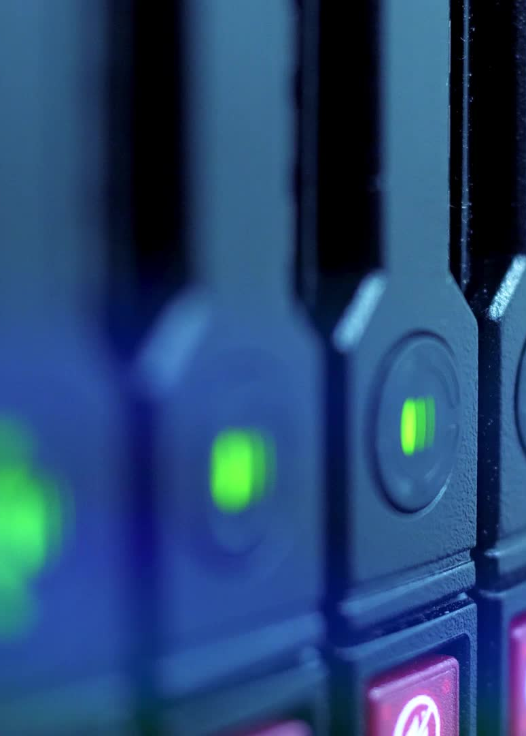
Strong Database Support
Native Support for Multiple Database Systems
PHP works seamlessly with nearly all modern database systems:
Relational Databases
MySQL/MariaDB (most popular with PHP)
PostgreSQL
SQLite
Oracle
Microsoft SQL Server
NoSQL Databases
MongoDB
Redis (key-value store)
Elasticsearch
Cloud Databases
Amazon RDS
Google Cloud SQL
Azure Database

Slide 8

Now let’s see how PHP works
Create a new folder and use your terminal to get there
Type: git clone https://github.com/BJcheng935/WDC_PHP_Basics.git
This will save a copy of the project into that new folder now. This is how to run it:
Once you have it on your terminal, type: php -S localhost:8000
Open your browser and paste this: https://localhost:8000
Once there now you can register first and then log in.
Any account created by you will be saved on users.json, it’s under the auth folder

Slide 9
